Slide 1
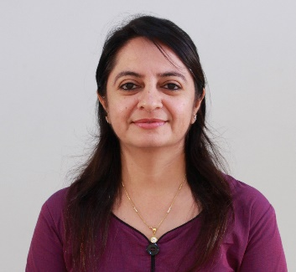
Software Engineering (#2101CS503)
Lab -1
Practical-2 Project Definition and Analysis
Prof. Devangi L. Kotak
Computer Science & Engineering Department
Devangi.kotak@darshan.ac.in

Slide 2




What is a project introduction
A project introduction is a paragraph or paragraphs explaining what a project is about.
It should include key details about the project that give the reader enough information to understand the purpose and scope of the project.
Communication
Analysis
Thinking
Team Meeting

Slide 3
Guidelines project introduction
When Write introduction?
Once your project analysis is complete
What Should Include?
Current situation: Describe the problem or opportunity
Objectives: Describe objectives or goals in order to solve the problem
Key Feature: Describe important characteristics of Project

Slide 4
Example: Introduction of Library Management System
A college library management is a project that manages and stores books information electronically according to students needs.
The system helps both students and library manager to keep a constant track of all the books available in the library.
It allows both the admin and the student to search for the desired book.
It becomes necessary for colleges to keep a continuous check on the books issued and returned and even calculate fine.

Slide 5
What is Key Feature
Key Features means the document describing the important characteristics of the Plan to which your application relates including its aims and associated risks.
Example: Key Feature of LMS
Control the movement of books and other material and avoid losing the same.
Search if you have a specific book in your collection based on the title, author etc.
Print the spine labels for the book.
Find what a specific person has borrowed from you. It offers the following modules Cataloguing, Circulation, Queries.
Member Can view the different categories of books available in the library.
Member Can view the List of books available in each category.
Member Can own an account in the library.
Member Can view the books issued to him.
Member Can put a request for a new book.

Slide 6
Functional and Non Functional Requirement
What is Functional Requirement
A Functional Requirement is a description of the service that the software must offer.
A function is nothing but inputs to the software system, its behavior, and outputs.
What is Non Functional Requirement
Non functional requirements define constraints which affect how the system should do it.
They specify the quality attribute of the software.
Non functional requirements deal with issues like scalability, maintainability, performance, portability, security, reliability, and many more

Slide 7
Library Management System
Function Requirements
Non-function Requirements
Add Article: New entries must be entered in database
Update Article: Any changes in articles should be updated in case of update
Delete Article: Wrong entry must be removed from system
Inquiry Members: Inquiry all current enrolled members to view their details
Bar-coding: To give specific identification to each book. All books, old and new, are bar-coded on the basis of title, author, topic and date of publishing.
Check out Article: To issue any article must be checked out
Check In article: After receiving any article system will reenter article by Checking
Search function: to enable both the librarian and the members to search the catalog of books in the library. The search functions can be filtered to the need of each user.
Usability: The UI should be simple enough for everyone to understand and get the relevant information without any special training. Different languages can be provided based on the requirements.
Accuracy: The data stored about the books and the fines calculated should be correct, consistent, and reliable.
Availability: The System should be available for the duration when the library operates and must be recovered within an hour or less if it fails. The system should respond to the requests within two seconds or less.

Slide 8

Software Engineering (2101CS0503)
Prof. Devangi L. Kotak
Computer Engineering Department
Devangi.kotak@darshan.ac.in

